Slide 1
Algorithms and Data Structures (CIS1002-N)
Week 3: Big-O Notation
Module Leader: Dr Annalisa Occhipinti
Email: A.Occhipinti@tees.ac.uk

Slide 2
This Lecture’s Topic
Introduction to the concept of O-notation (Big-O Notation) – Part 2
How to measure the efficiency of an algorithm

Slide 3
Introduction to O-notation
O-notation (pronounced “big Oh notation”) is a way of quantifying the efficiency of an algorithm… in terms of the amount of units of time it takes to run the algorithm on data sets of different sizes.
i.e. as the dataset increases, how does the amount of time to perform the same algorithm change/increase?
in the same proportion? Twice as fast? Exponentially faster?…
Big-O notations is interested in the worst case scenario!
Example: How many units-of-time does a searching algorithm take if the number is at the end of the array?
Notes:
Two algorithms we have already seen in class

Slide 4
Introduction to O-notation
For example, sorting/searching algorithms all accomplish the same goal – finding an element that matches a given search key.
There are, however, a number of things that differentiate search algorithms from one another.
The major difference is the amount of effort they require to complete the sort/search.
Notes:
Two algorithms we have already seen in class.
So in the worst case, if you have n element in the array, it’ll take n units of time

Slide 5
Introduction to O-notation
O-notation is a way to describe the time-effort of an algorithms. It indicates the worst-case run time for an algorithm.
In other words, how hard an algorithm may have to work to solve a problem.
For searching and sorting algorithms, this depends particularly on how many data elements there are.
Notes:
Two algorithms we have already seen in class.
So in the worst case, if you have n element in the array, it’ll take n units of time

Slide 6
From last week…
We saw 3 different orders of complexity…do you remember them?

Slide 7
Introduction to O-notation
Let’s introduce this concept using :
a linear search algorithm
a binary search algorithm
Notes:
Two algorithms we have already seen in class

Slide 8
Key Concepts
O-notation measures the efficiency of an algorithm (how many units of time the algorithm take to do run in the worst case scenario)
It measures how the number of time-units to run changes if the data-size increases.

Slide 9
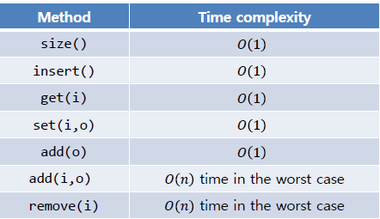
Big O notation and Dynamic Arrays
Describes an upper bound for the running time T(n) of an algorithm (worst case running time)
The O symbol was introduced in 1927 to indicate relative growth of two functions…
The running time of an algorithm typically grows with the input size.
Time Complexity:

Slide 10
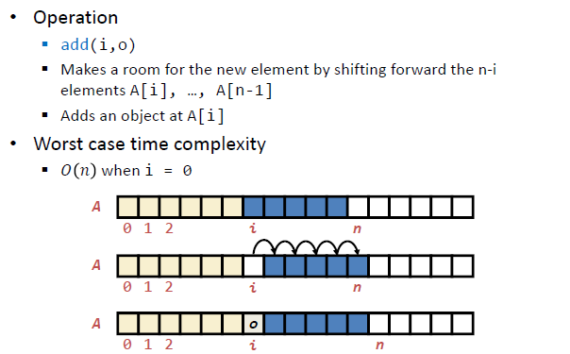
Time Complexity: Insertion

Slide 11
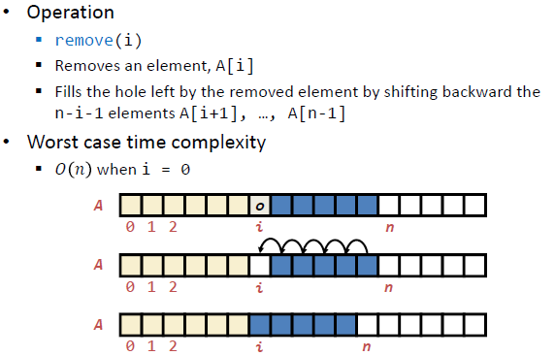
Time Complexity: Removing

Slide 12
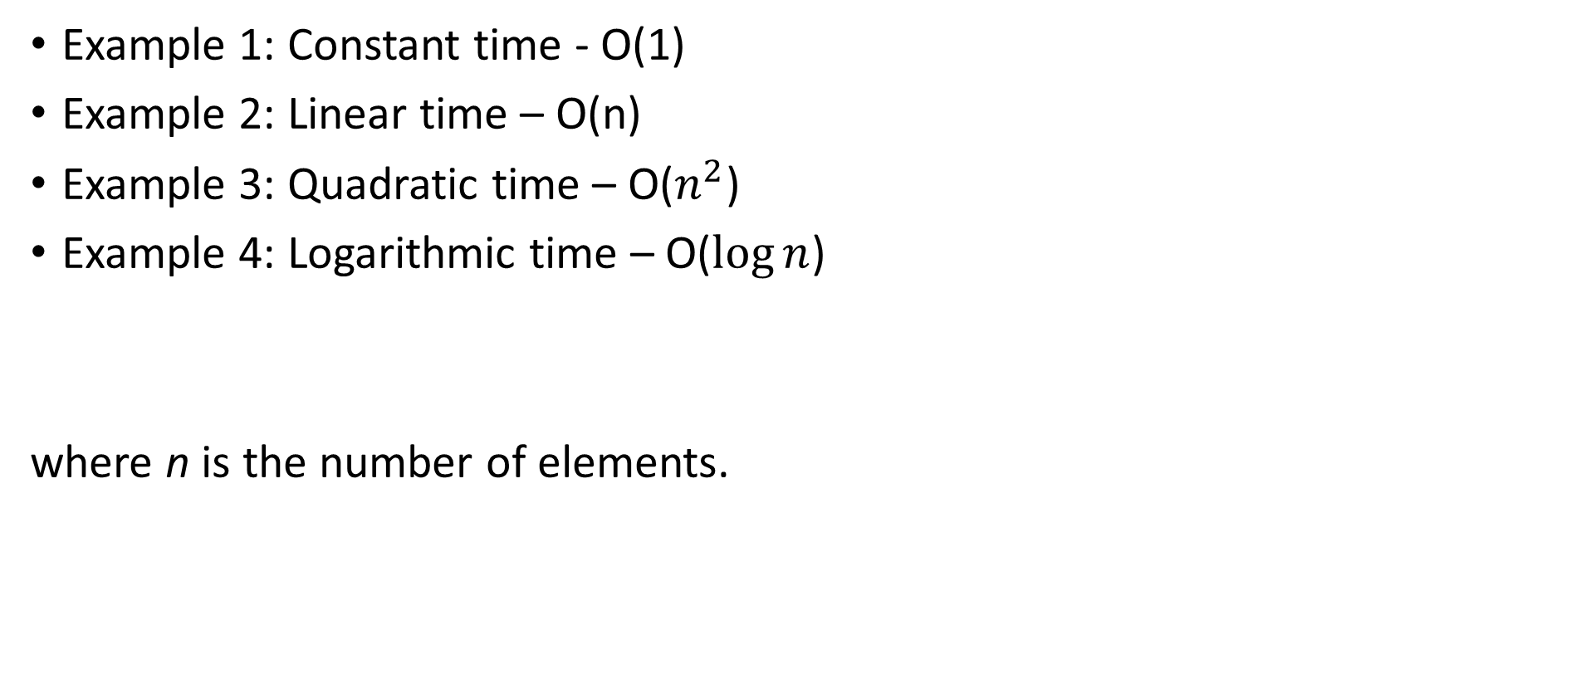
Let’s see how O-notation works…
Example 1: Constant time - O(1)
Example 2: Linear time – O(n)
Example 3: Quadratic time – O($n^{2}$)
Example 4: Logarithmic time – O($\log{n}$)
where n is the number of elements.

Slide 13
Example 1 – Constant run-time – O(1)
Suppose an algorithm is designed to test whether the first element of an array is equal to the second.
If the array has 10 elements, this algorithm requires one comparison.
If the array has 1000 elements, it still requires one comparison.
In fact, the algorithm is completely independent of the number of elements in the array.
This algorithm is said to have a constant run time, which is represented in big O-notation as O(1).

Slide 14
Example 1 – Constant run-time – O(1)
An algorithm that is O(1) does not necessarily require only one comparison. O(1) just means that the number of comparisons is constant – it does not grow as the size of the array increases.
i.e. it takes the same time to perform the algorithm whatever the size of the array.
An algorithm that tests whether the first element of an array is equal to any of the next three elements is still O(1) even though it requires three comparisons.

Slide 15
Example 2 – Linear run time – O(n)
The Linear search algorithm searches each element in an array sequentially. If the search key does not match an element in the array, the algorithm tests each element until all are tested.
If the search key is in the array, the algorithm tests each element until it finds one that matches the search key and returns the index of that element.
Big-O notations is interested in the worst case scenario!
Notes:
Two algorithms we have already seen in class.
So in the worst case, if you have n element in the array, it’ll take n units of time

Slide 16
Example 2 – Linear run time – O(n)
The algorithm tests whether the first array element is equal to any of the other array elements will require at most n-1 comparisons, where n is the numbers of array elements.
If the array has 10 elements, this algorithm requires up to nine comparisons.
If the array has 1000 elements, it requires up to 999 comparisons.

Slide 17
Example 2 – Linear run time – O(n)
As n grows larger, the n part of the expression n - 1 “dominates”, and subtracting one becomes inconsequential. Big O is designed to highlight these dominant terms and ignore terms that become unimportant as n grows.
For this reason, an algorithm that requires a total of n-1 comparisons (such as the one just described) is said to be O(n), and pronounced “order n” or “Oh of n”.
An O(n) algorithm is referred to as having a linear run time.

Slide 18
Example 3 – Quadratic run time – O(n²)
Now suppose you have an algorithm that tests whether any element of an array is duplicated elsewhere in the array.
The first element must be compared with every other element in the array.
The second element must be compared with every other element except the first (it was already compared to the first).
The third element must be compared with every other element except the first two.

Slide 19
Example 3 – Quadratic run time – O(n²)
In the end, this algorithm will end up making :
(n-1) + (n-2) + … + 2 + 1 or (n – 1)*n/2 comparisons.
As n increases, the n² term dominates and the n term becomes inconsequential.
Big O-notation highlights the n² term, leaving n²/2.
But constant factors are omitted in big O notation as we are only interested in the general order of growth.
Notes:
Plot n² against n on the board

Slide 20
Example 3 – Quadratic run time – O(n²)
In the end, this algorithm will end up making :
(n-1) + (n-2) + … + 2 + 1 or (n – 1)*n/2 comparisons.
= number of elements * average term
but average term = (first + last)/2
As n increases, the n² term dominates and the n term becomes inconsequential.
Big O-notation highlights the n² term, leaving n²/2.
But constant factors are omitted in big O notation as we are only interested in the general order of growth.
Notes:
Plot n² against n on the board

Slide 21
Example 3 – Quadratic run time – O(n²)
Big O is concerned with how an algorithm’s run-time grows in relation to the number of items processed.
Suppose an algorithm requires n² comparisons.
With four elements, the algorithm requires 16 comparisons;
with eight elements, 64 comparisons.
So with this algorithm, doubling the number of elements quadruples the number of comparisons.

Slide 22
Example 3 – Quadratic run time – O(n²)
Consider now a similar algorithm requiring n²/2 comparisons.
With four elements, the algorithm requires eight comparisons;
with eight elements, 32 comparisons.
Again, doubling the number of elements quadruples the number of comparisons.

Slide 23
Example 3 – Quadratic run time – O(n²)
Both of these algorithms grow as the square of n,
so Big O ignores the constant and both algorithms are considered to be O(n²), which is referred to as quadratic run-time and pronounced “order n-squared”.
When n is small, O(n²) will not noticeably affect performance, but as n grows a clear performance degradation is observable.
Notes:
Show how we are neither interested in constants nor in minor terms as these become insignificant as n grows large !

Slide 24
Example 3 – Quadratic run time – O(n²)
An O(n²) algorithm running on a million-element array would require a trillion operations which could take several hours.
A billion-element array would require a quintillion operations, a number so large that the algorithm would take decades!
Unfortunately, O(n²) algorithms are easy to write.
There are more efficient algorithms, but these require a bit more cleverness and work to create.

Slide 25
Example 3 – Quadratic run time – O(n²)
However their superior performance can be well worth the extra effort, especially as n gets large and as algorithms are combined into larger programs.
The linear search algorithm is O(n) time.
The worst case in this algorithm is that every element must be checked to determine whether the search item exists in the array.
If the size of the array is doubled, the number of comparisons that the algorithm must perform is also doubled.
Note that it can provide outstanding performance if the element matching the search key happen to be at or near the front of the array.

Slide 26
Example 4 – binary search algorithm
The binary search algorithm is more efficient than linear search, but it requires that the array be sorted.
The first iteration of this algorithm tests the middle element in the array. If this matches the search key, the algorithm ends.
Assuming the array is sorted in ascending order, then if the search key is less than the middle element, it cannot match any element in the second half of the array and the algorithm continues with only the first half of the array (i.e. the first element up to, but not including, the middle element).

Slide 27
Example 4 – binary search algorithm
The algorithm then checks 65 (the search key) with 65 (the middle element), which matches the search key
and returns the index of the array element containing 65.
How many comparisons?
This algorithm requires just three comparisons to determine whether the search key matched an element of the array!
Using a linear search algorithm would have required 10 comparisons

Slide 28
Example 4 – binary search algorithm
If the search key is greater than the middle element, it cannot match any element in the first half of the array and the algorithm continues with only the second half (i.e. the element after the middle element through to the last element).
Each iteration tests the middle value of the remaining portion of the array. If the search key does not match the element, the algorithm eliminates half of the remaining elements.
The algorithm ends by either finding an element that matches the search key or reducing the sub-array to zero size.

Slide 29
Example 4 – binary search algorithm
Consider the following sorted 15-element array :
2 3 5 10 27 30 34 51 56 65 77 81 82 93 99
and a search key of 65.

Slide 30
Example 4 – binary search algorithm
Consider the following sorted 15-element array :
2 3 5 10 27 30 34 51 56 65 77 81 82 93 99
and a search key of 65.
65 is compared to 51 (the middle element), but 65 > 51
therefore 51 is discarded together with the first half of the array, leaving:
56 65 77 81 82 93 99
Next, 65 is compared to 81, but 65 < 81
therefore 81 is discarded together with the second half, leaving : 56 65 77

Slide 31
Binary Search :
binary tree depth = ?
a-z
1
a-m n-z
2
a-g h-m n-t u-z
3
a-d e-g h-j k-m n-q r-t u-w x-z
4
a-b c-d e-f g h-i j k-l m n-o p-q r-s t u-v w x-y z
5
N = 32 elements
a b c d e f h i k l n o p q r s u v x y
Notes:
As a practical example, let’s now turn our attention to a binary tree.
Here a binary search; basically, we are looking for a word in a dictionary, we keep halving our dictionary in two parts (left and right), check which half our word belongs to, and so on until we hit the letter corresponding to the initial of the word we are looking for.
There is only a single path being taken from the root to the leaf corresponding to the word we are looking for. Depending on the input dataset n (here 26 letters) it takes log₂(closest power of 2 greater than n) levels in the tree before we hit the leaf. In other words the tree depth is log₂(n)

Slide 32






























Binary Search :
Notes:
As a practical example, let’s now turn our attention to a binary tree.
Here a binary search; basically, we are looking for a word in a dictionary, we keep halving our dictionary in two parts (left and right), check which half our word belongs to, and so on until we hit the letter corresponding to the initial of the word we are looking for.
There is only a single path being taken from the root to the leaf corresponding to the word we are looking for. Depending on the input dataset n (here 26 letters) it takes log₂(closest power of 2 greater than n) levels in the tree before we hit the leaf. In other words the tree depth is log₂(n)

Slide 33




Slide 34
Binary Search :
binary tree depth = log₂(n)
a-z
log₂(2) = 1
a-m n-z
log₂(4) = 2
a-g h-m n-t u-z
log₂(8) = 3
a-d e-g h-j k-m n-q r-t u-w x-z
log₂(16) = 4
a-b c-d e-f g h-i j k-l m n-o p-q r-s t u-v w x-y z
worst case log₂(32) = 5
N = 32 elements
a b c d e f h i k l n o p q r s u v x y
Notes:
As a practical example, let’s now turn our attention to a binary tree.
Here a binary search; basically, we are looking for a word in a dictionary, we keep halving our dictionary in two parts (left and right), check which half our word belongs to, and so on until we hit the letter corresponding to the initial of the word we are looking for.
There is only a single path being taken from the root to the leaf corresponding to the word we are looking for. Depending on the input dataset n (here 26 letters) it takes log₂(closest power of 2 greater than n) levels in the tree before we hit the leaf. In other words the tree depth is log₂(n)

Slide 35
Example 5 – binary search algorithm
If n = 7 the worst-case scenario is log₂(7) = 2.807 3 comparisons
Looking for number 4
1 | 5 | 7 | 9 | 10 | 12 | 14
1 | 5 | 7
1

Slide 36
Example 6 – binary search algorithm
If n = 7 the worst-case scenario is log₂(7) = 2.807 3 comparisons
If n = 10 the worst-case scenario is log₂(10) = 3.32 4 comparisons
If n = 15 the worst-case scenario is log₂(15) = 3.91 4 comparisons
Looking for number 4
1 | 5 | 7 | 9 | 10 | 12 | 14 | 17 | 20 | 24
1 | 5 | 7 | 9 | 10
1 | 5
5

Slide 37
Example 6 – binary search algorithm
If n = 7 the worst-case scenario is log₂(7) = 2.807 3 comparisons
If n = 10 the worst-case scenario is log₂(10) = 3.32 4 comparisons
If n = 100 the worst-case scenario is log₂(100) = 6.64 7 comparisons
If n = 1000 the worst-case scenario is log₂(1000) = 9.97 10 comparisons
Looking for number 4
1 | 5 | 7 | 9 | 10 | 12 | 14 | 17 | 20 | 24
1 | 5 | 7 | 9 | 10
1 | 5
5

Slide 38
Reviewing Logarithms intuitively…
2³ = 2 x 2 x 2 = 8 and so log₂(8) = 3
2⁶ = 2 x 2 x 2 x 2 x 2 x 2 = 64 so log₂(64) = 6
6 times
Notes:
Logarithm is an anagram of Algorithm !
Logarithms come into various families, we talk of bases. and so we have log base 2, log base 10, log base e (called Neperian or natural logarithm), etc…
When we raise a number to a power, the root function gets you back to the original number; in this respect you could view the functions raising to a power and taking the corresponding root as opposite or inverse functions.
i.e. if a^{b} = c then ^{b}√ c = a
Similarly, when we raise a number to a power, the log function of the corresponding base recovers the power, so in a different way, raising to a power and taking the corresponding logarithm are also opposite or inverse functions.
i.e. if a^{b} = c then log_{a}(c) = b
Finally, note that log_{a} c = log_{b} c / log_{b} a = coeff × log_{b} c
And since in O-notation we ignore coefficients, we simply write log n without indicating the base !

Slide 39

Efficiency of binary search algorithm
In the worst case scenario, searching a sorted array of 1023 elements takes only 10 comparisons when using a binary search.
Repeatedly dividing 1023 by 2, since after each comparison we can eliminate half the array,
and rounding down because we also remove the middle element, yields the values :
511, 255, 127, 63, 31, 15, 7, 3, 1 and 0
The number 1023 (2¹⁰ – 1) is divided by 2 only 10 times to get the value 0 which indicates that there are no more elements to test.

Slide 40

Efficiency of binary search algorithm
Dividing by 2 is equivalent to one comparison in the binary search algorithm,
thus arrays of:
Number of elements max No of comparisons
1,048,575 =(2²⁰ – 1) takes 20
Over 1 billion takes 30
$$2^{30}=\text{1}\text{,}\text{073}\text{,}\text{741}\text{,}\text{824}$$

Slide 41
Efficiency of binary search algorithm
Dividing by 2 is equivalent to one comparison in the binary search algorithm,
This is a tremendous improvement in performance over the linear search, which takes on average 500 million comparisons (average of 1 in the best case and 1 billion in the worst case).
Compare 30 with 500 million!!!

Slide 42
Example 4 – logarithmic run time – O(log n)
The maximum number of comparisons needed for the binary search of any sorted array is the exponent of the first power of 2 greater than the number of elements in the array, which is represented by log₂ n
All logarithms grow at roughly the same rate, so in big O notation the base can be omitted.
This results in a big O of O(log n) – pronounced order log n - for a binary search, which is also known as logarithmic run-time.

Slide 43
Binary Search
So when attempting to locate an element in an array of n pieces of data using Binary search, we need only follow a single path down the binary search tree.
It takes therefore 1 x depth of the tree number of operations
In other words, 1 x log n operations or units of time.
We say Binary search is an algorithm that has a performance of O(log n).

Slide 44
Some common complexity classes
Name | O - Notation
Constant | O(1)
Logarithmic | O(log n)
Linear | O(n)
n log n | O(n log n)
Quadratic | O(n²)
Cubic | O(n³)
Exponential | O(2^{n})
Exponential | O(10^{n})
http://bigocheatsheet.com/
http://bigocheatsheet.com/

Slide 45
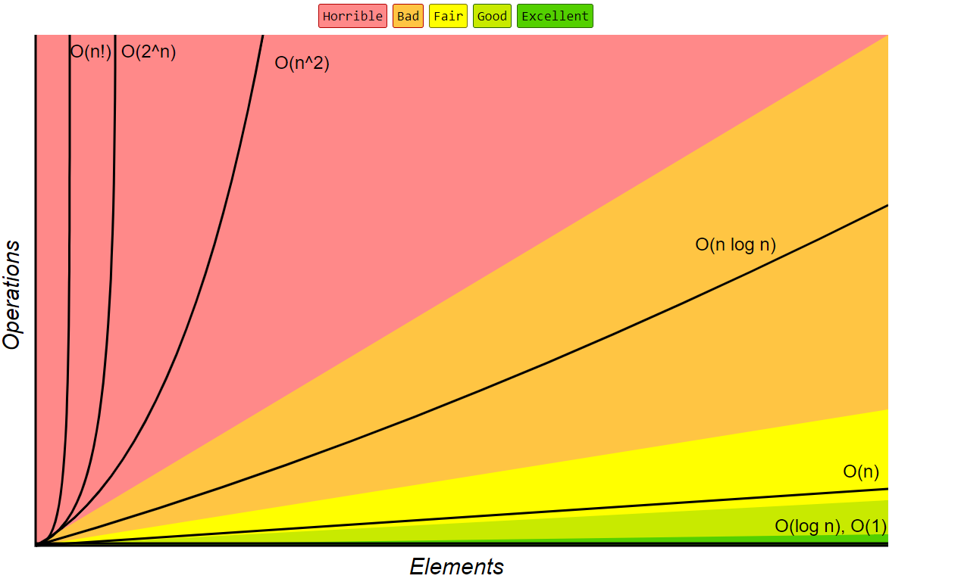

Slide 46
f₆(x) = n³
f₇(x) = 2^{n}
f₅(x) = n²
f₄(x) = n log n
f₃(x) = n

Slide 47
f₆(x) = n³
f₇(x) = 2^{n}
f₅(x) = n²
f₄(x) = n log n
f₃(x) = n

Slide 48
f₅(x) = n²
f₄(x) = n log n
f₃(x) = n
f₂(x) = log n
f₁(x) = 1

Slide 49
Scale of Strength for O - Notation
O(1) < O(log n)< O(n) < O(n log n) < O(n²) < O(n³) < O(2^{n}) <O(10^{n})
←----- from better to worse ----→

Slide 50
Homework Questions
What is the time complexity of Bubble Sort, Insertion Sort and Selection Sort?
Justify your answer.
You should think of the number of comparisons that each algorithm requires

Slide 51
O-notation in Sorting Algorithms

Slide 52
Sorting algorithms
We are given n records to sort.
There are a number of simple sorting algorithms whose time performance is quadratic O(n²):
Bubble sort
Cocktail Shaker sort
Selection sort
Insertion sort
The faster comparison based algorithm are O(n log n)
Mergesort
Quicksort

Slide 53
Bubble Sort Time Analysis
In O-notation, what is the running time for n items?
Steps of algorithm:
for i = 1 to n-1
starting from left, compare each cell with its immediate neighbour
if elements out of order, swap until largest at right-end of array
if no elements swapped in this pass through array, done.
otherwise, decrease size of unsorted array by 1 and continue
Bubble sort analysis: O(n²)
Outer loop O(n)
Inner loop O(n)
Notes:
The brute force approach is to pass through the array until no swaps are performed, indicating that the array is sorted.
An improvement is obtained if we scan over 0: i – 1 if i is the outer loop variable (i.e. reducing the array by one each pass). This produces a twofold gain of speed.

Slide 54
Selection Sort Time Analysis
In O-notation, what is the running time for n items?
Steps of algorithm:
for i = 1 to n-1
find smallest key in unsorted part of array
swap smallest item to front of unsorted array
decrease size of unsorted array by 1
Selection sort analysis: O(n²)
O(n)
O(n)

Slide 55
Insertion Sort Time Analysis
In O-notation, what is the running time for n items?
Steps of algorithm:
for i = 1 to n-1
take next key from unsorted part of array
insert in appropriate location in sorted part of array:
for j = i down to 0,
shift sorted elements to the right if key > key[i]
increase size of sorted array by 1
Insertion sort analysis: O(n²)
Outer loop:
O(n)
Inner loop:
O(n)

Slide 56
Analysis of Sorting Algorithms - Summary
Selection sort, Insertion sort, and Bubble sort all have a worst-case time of O(n²), making them impractical for large arrays.
But they are easy to program, easy to debug.
Insertion Sort also has good performance when the array is nearly sorted to begin with.
But more sophisticated sorting algorithms are needed when good performance is needed in all cases for large arrays.
Notes:
A quick summary of these algorithms' timing properties.

Slide 57





Quick Question:
Selection sort has been applied to the array below. Can you spot the mistake?
A= {3, 7, 4, 0, 1, 5}

Slide 58
Test – Week 3 – Big-O Notation

Slide 59
Interview Question**:
Write a function to swap two numbers in place without a temporary variable.
Hint: make use of your mathematical knowledge…

